Slide 1
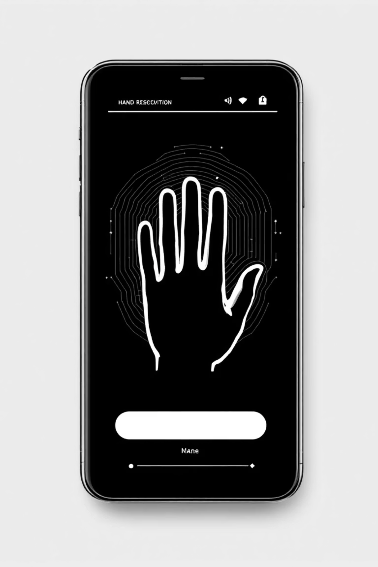
Eucliance - Hand Gesture Recognition
A sophisticated real-time hand tracking application powered by OpenCV, MediaPipe, and Tkinter

Slide 2
Project Overview
Core Technology Stack
Key Features
OpenCV for video capture and processing
Real-time hand landmark detection
MediaPipe Hands for gesture detection
Euclidean distance calculations
Tkinter for professional GUI interface
Visual bounding box tracking
NumPy for mathematical computations
Professional dark-themed interface
Pillow for image rendering
Multi-threaded video processing

Slide 3
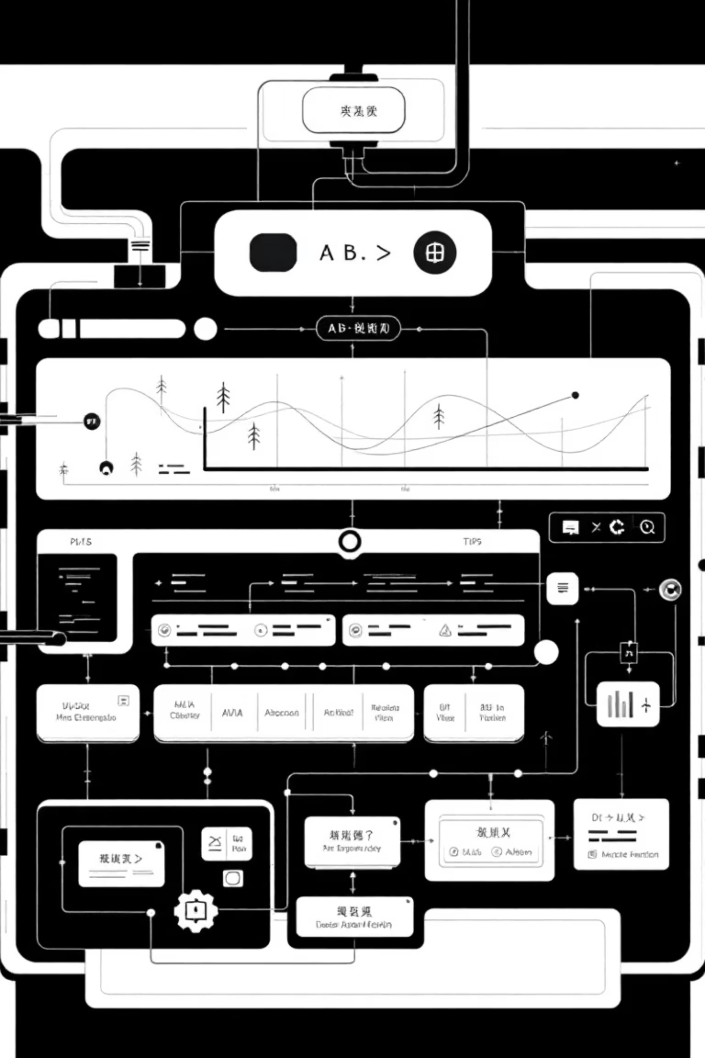
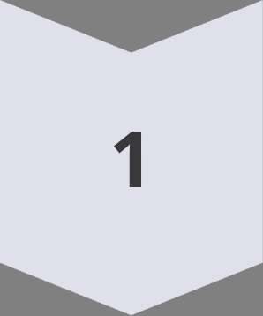
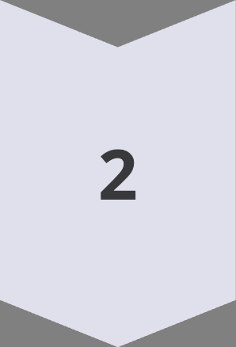
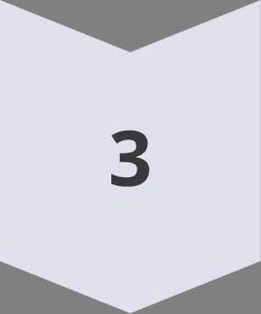
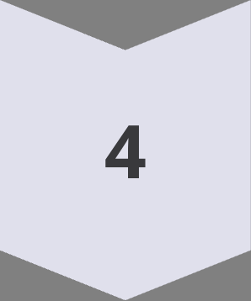
System Architecture
Camera Input
Webcam captures live video feed at real-time frame rates
MediaPipe Processing
Hand detection and landmark extraction with 21 key points
Data Computation
Calculate distances and coordinate transformations
GUI Rendering
Display annotated video and real-time data table

Slide 4
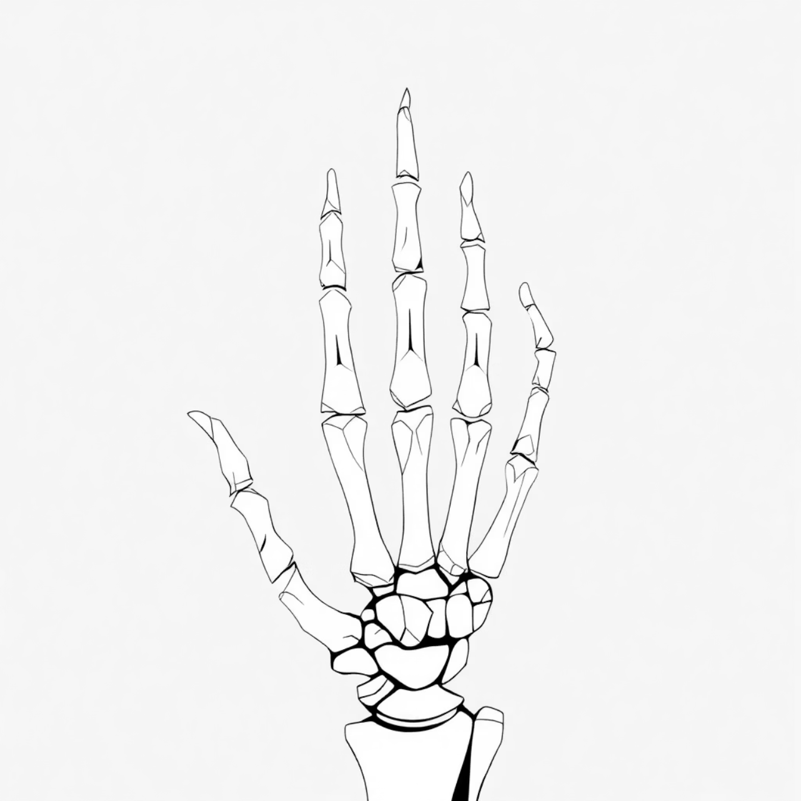
Hand Landmark Detection
21-Point Tracking System
MediaPipe Hands identifies 21 distinct landmarks across the hand, providing comprehensive tracking of finger positions, palm structure, and wrist location.
Detection Parameters
Max hands: 1 (optimized performance)
Detection confidence: 60%
Tracking confidence: 60%
3D coordinates: X, Y, Z values

Slide 5

Euclidean Distance Calculation
Distance Formula
Gesture Recognition
Normalized Precision
Calculates 3D Euclidean distance between thumb tip (landmark 4) and index finger tip (landmark 8)
Enables pinch detection and measurement for interactive gesture-based controls
Returns values in normalized coordinate space for consistent accuracy across resolutions

Slide 6
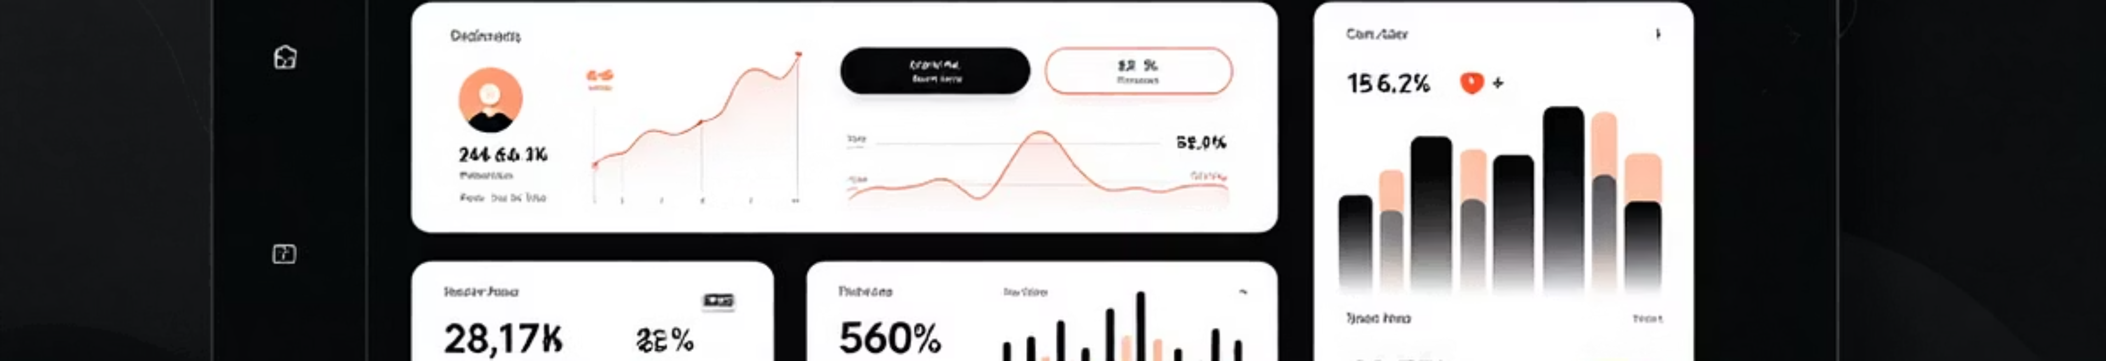
User Interface Design
Professional Color Palette
Dual-Panel Layout
Typography System
Dark theme optimized for extended viewing with carefully selected contrast ratios
Split-screen design with video feed on left and real-time landmark data table on right
Segoe UI for headers and Consolas monospace font for technical data display
Background: #2c2c2c
Frame: #3e3e3e
Foreground: #f0f0f0

Slide 7
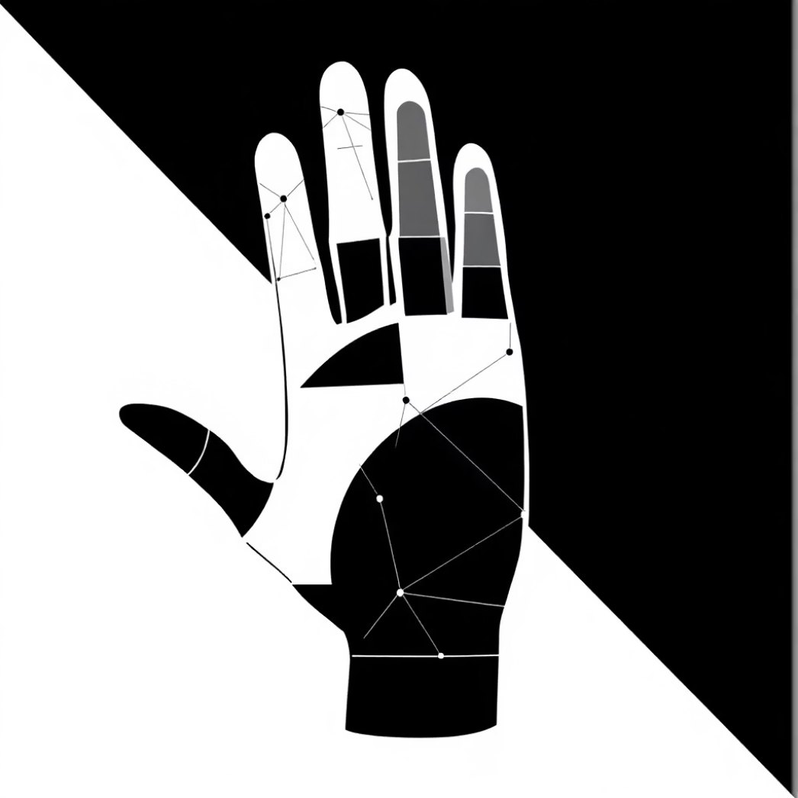
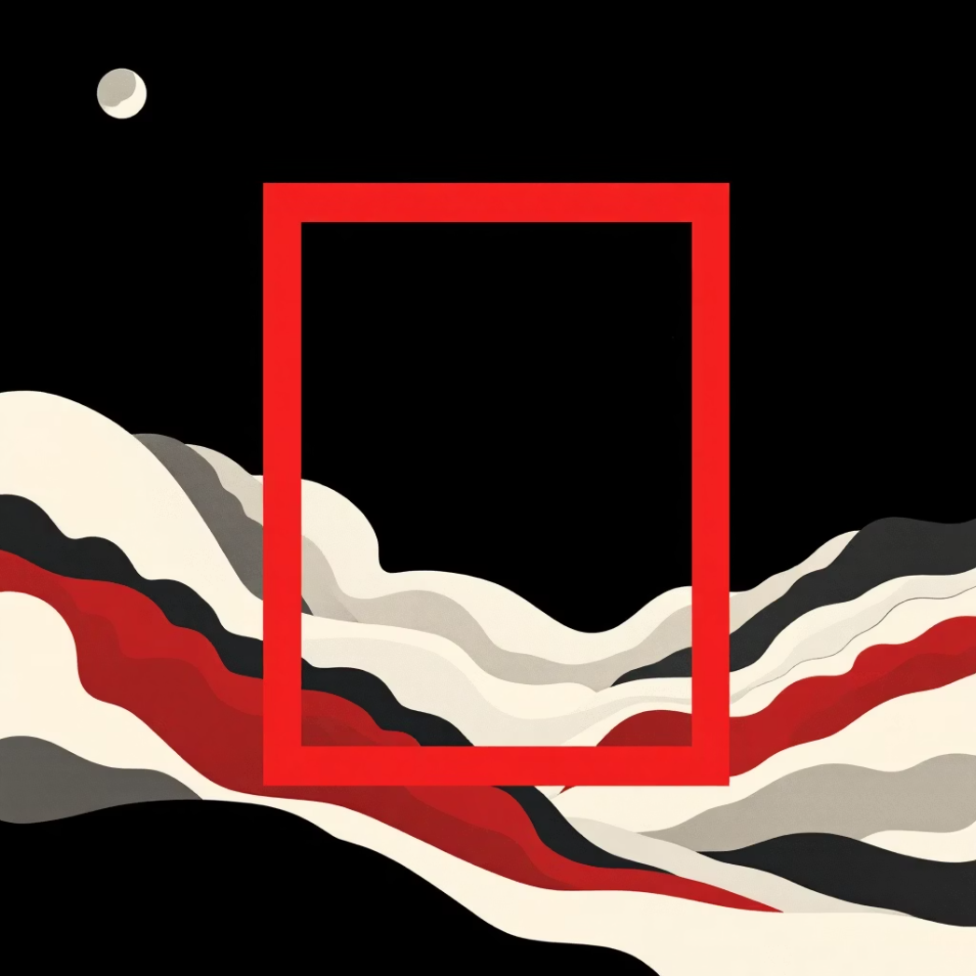
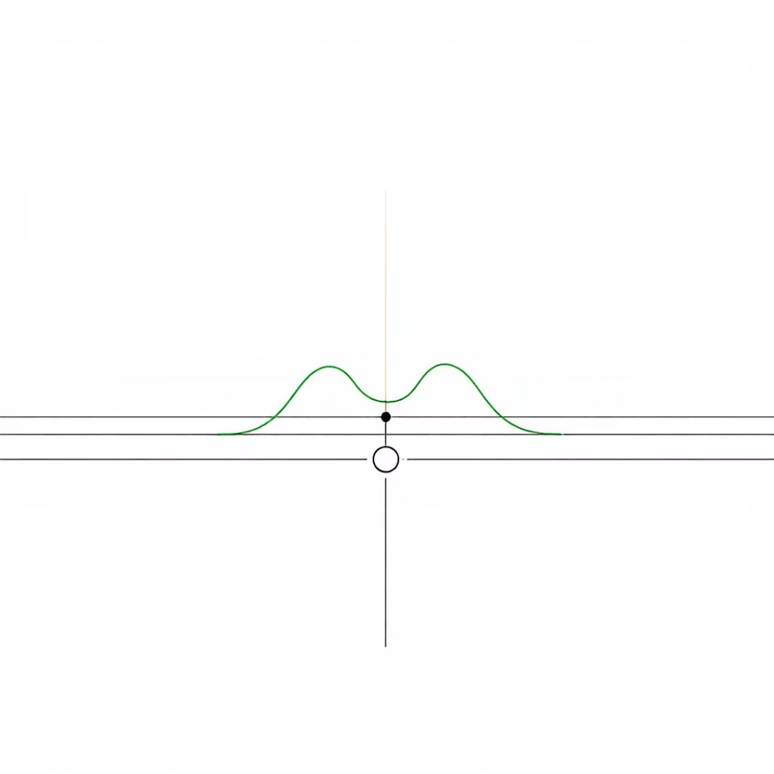
Visual Feedback System
Landmark Visualization
Bounding Box
Distance Indicator
Green dots mark each of the 21 hand landmarks, connected by white lines showing hand structure
Red rectangular frame dynamically tracks hand movement and size in the frame
Bright green line with numerical distance display between thumb and index finger

Slide 8
Technical Implementation
01
02
03
Library Initialization
Camera Setup
Threading Architecture
Version checking and validation of OpenCV, MediaPipe, NumPy, Tkinter, and Pillow dependencies
OpenCV VideoCapture initialization with error handling for webcam access
Separate video processing thread prevents GUI freezing during intensive computations
04
05
06
Frame Processing
Coordinate Extraction
Visual Annotation
BGR to RGB conversion, horizontal flip, and MediaPipe hand detection pipeline
Landmark position retrieval and normalization for consistent tracking
Drawing utilities add landmarks, connections, bounding boxes, and distance measurements
07
GUI Update
Thread-safe updates to video label and data table using Tkinter's after() method

Slide 9
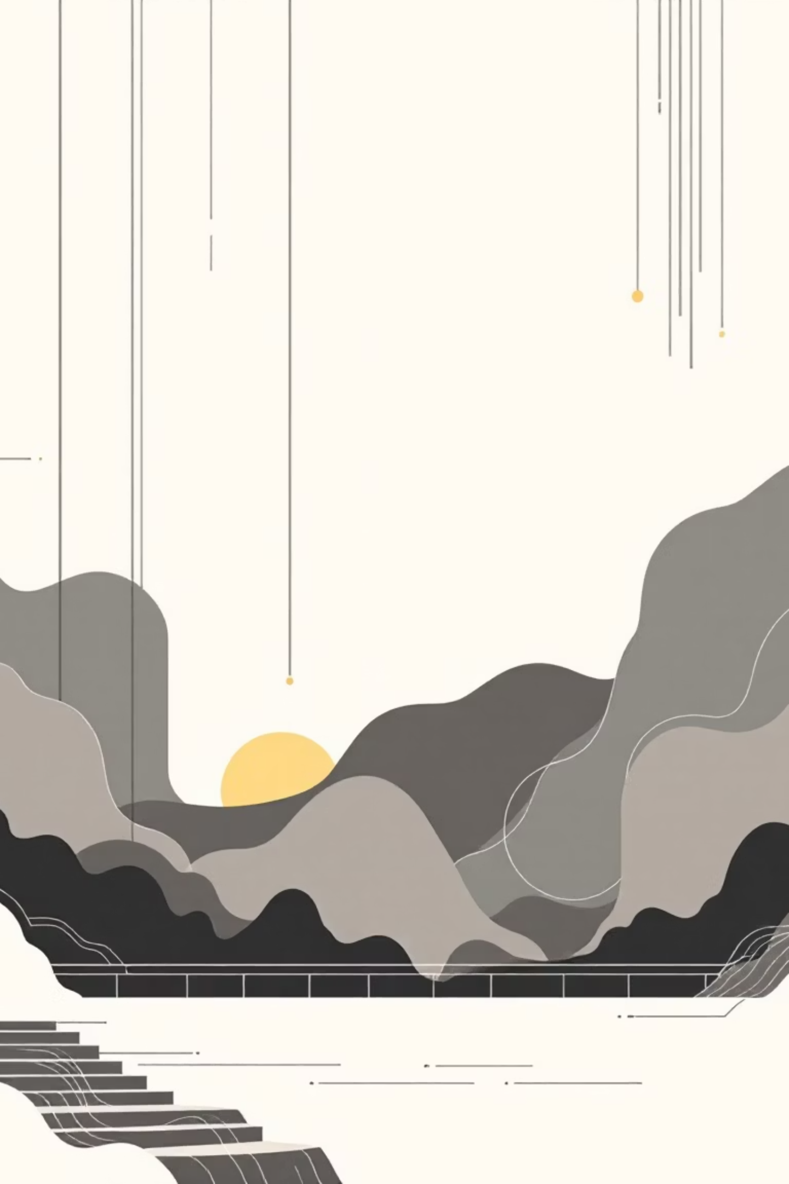
Data Output Display
Real-Time Landmark Table
Distance Metrics
Footer section shows calculated Euclidean distance between thumb and index finger tips.
Displays all 21 hand landmarks with precise X, Y, and Z coordinates in a monospace-formatted table for easy reading.
Applications
Gesture recognition triggers
Data Features
Virtual button interaction
Six decimal precision for accuracy
Fine motor skill analysis
Accessibility controls
Normalized coordinate system
Automatic N/A display when no hand detected

Slide 10
Project Information
🎓 Academic Context
🚀 Future Enhancements
💡 Applications
Institution: VIT Chennai
Touchless interface controls
Developer: Girija G
Multi-hand tracking support
Sign language recognition
Project Name: Eucliance
Custom gesture library
Virtual reality interactions
Machine learning integration
Medical rehabilitation tracking
Recording and playback features
A sophisticated demonstration of computer vision and human-computer interaction principles using modern Python libraries

